Slide 1




Slide 2
Azure is Global

Slide 3
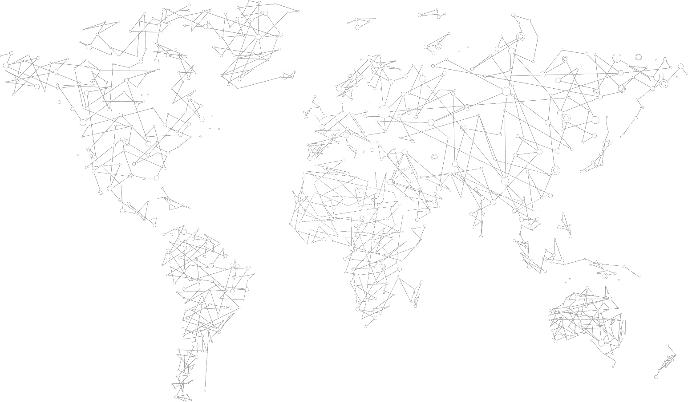




34
Azure regions
2X the number of AWS regions
NEWLY ANNOUNCED:
France: France Central and France South DoD East and Central

Slide 4
Azure as Innovation Enabler

Slide 5











Architectural Evolution

Slide 6



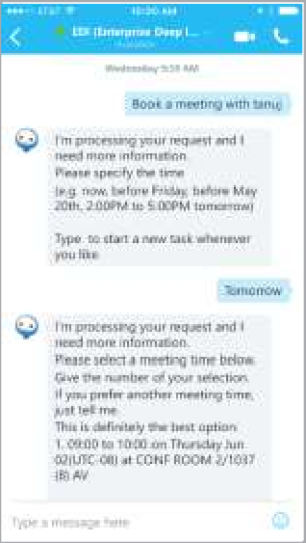
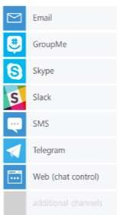





Learn and Engage

Slide 7



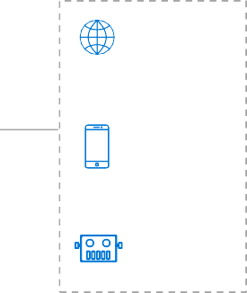



Data Driven Innovation
Information Management
Data Factory Data Catalog
Event Hubs
Big Data Stores
Data Lake Store
SQL Data Warehouse
Machine Learning and Analytics
Machine Learning
Data Lake Analytics
HDInsight (Hadoop and Spark)
Stream Analytics
Intelligence Capabilities
Cognitive Services
Bot Framework
Cortana
Data
Sources
People
Web
Apps
Mobile
Apps
Bots
Dashboards &
Visualizations
Power BI
Sensors and devices
Automated Systems
Data
Intelligence
Action

Slide 8




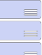
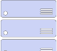

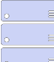
http://aka.ms/azposterapp
Platform Services
Security & Management
Service Creation & Configuration
User/Group Directory Store
Identity Sign-Up and sign-in
Multi-Factor Authentication
Scheduled Service Management
Task Scheduler
Encryption Key Store
Software/Solution Marketplace
Pre-Build VM Images
Hybrid Operations
Directory
Health Monitoring
Privileged Identity Management
Domain Join & Policy Management
Server Data Backup
Operational Analytics
Bulk Data Import And Export
Disaster Recovery
Hybrid/Intelligent Data Backup
Stateless Compute
Distributed Compute
Web Apps Infrastructure
API App Infrastructure
Relational SQL Database
Data Warehouse
Document Database Service
Scheduled Compute Jobs
Virtual App Streaming
Mobile Backends
Business Process Automation
Distributed In-Memory Cache
Search
Simple Key/Value Store
API
Management
Push Notifications
Simple Queuing
B2B
Integration
Hybrid Connections
Pub/Sub Queuing
Big Data Analytics
Predictive Analytics
Data Stream Analytics
Big Data Storage
Development Tools
Software Development Kits
Data Pipelines
Device Data Collection
Data Source Management
Live & OD Media Streaming
Content Delivery Network (CDN)
Software Lifecycle Management
Application Instrumentation
IoT Device Management
Mobile Analytics
Infrastructure Services

Slide 9
Azure is Open

Slide 10


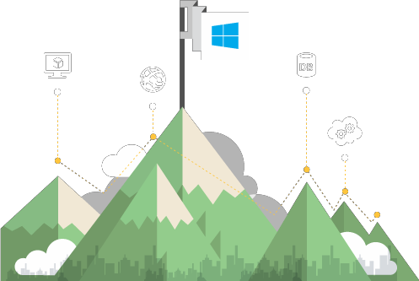
















Microsoft Azure: an Open Ecosystem

Slide 11
Azure is Control

Slide 12
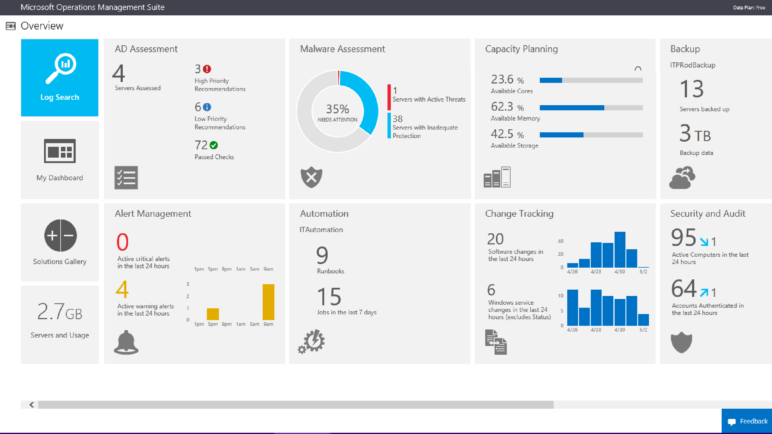

Slide 13
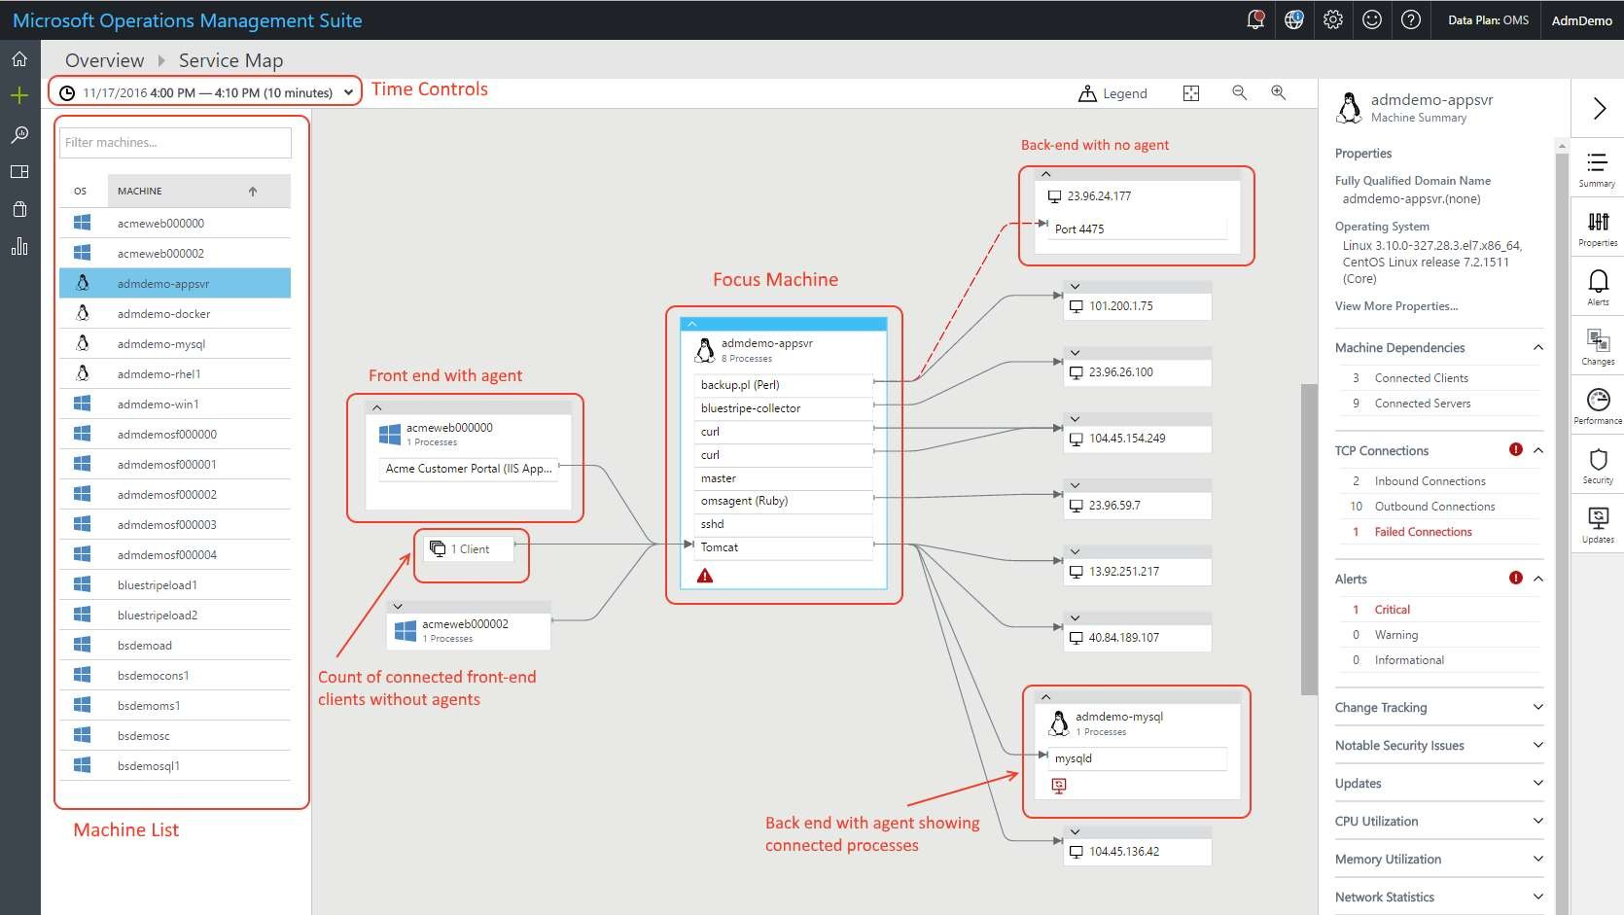

Slide 14
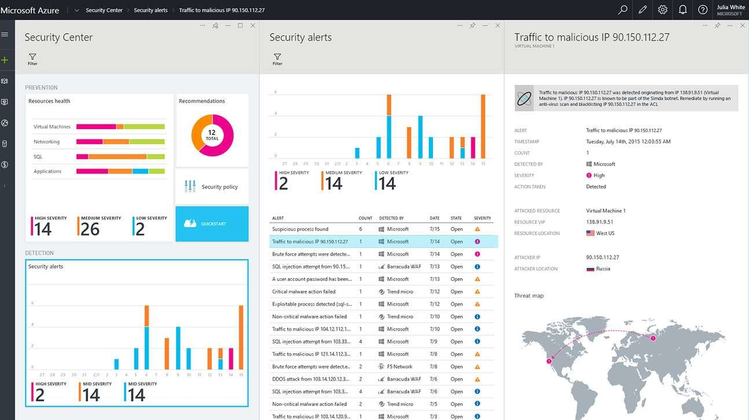

Slide 15



Network
Compute
Storage

Slide 16

































LOWEST PRICE
LARGEST SCALE-UP

Slide 17


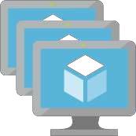







Slide 18









Slide 19










Slide 20
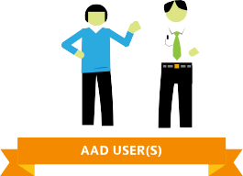
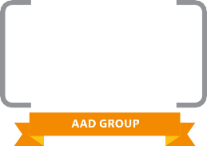


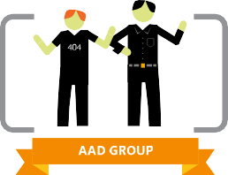


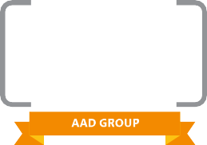














Slide 21



DBaaS
aPaaS
iPaaS

Slide 22







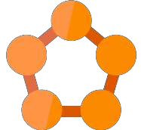






The Continuum from IaaS to PaaS
Cloud Foundry
Mesos
Docker Swarm
Kubernetes

Slide 23


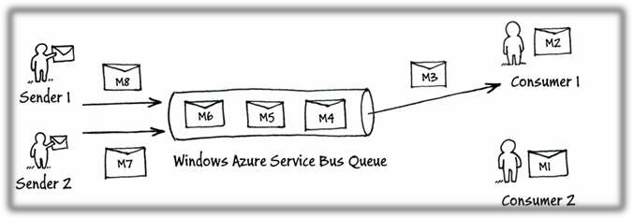
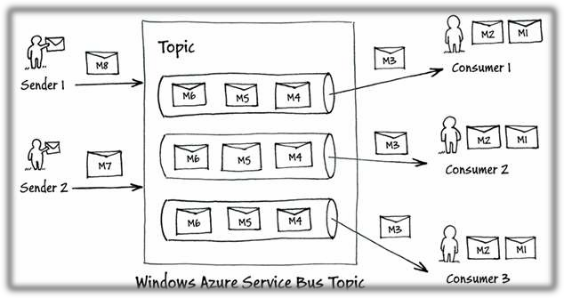

Slide 24




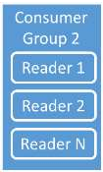
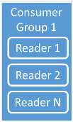

Event Hub
Event Consumer App 1
Event Publisher
Publisher
Policy
Revocation List
Partition 1
Partition 2
Partition N
Event Consumer App 2
Throughput Units

Slide 25







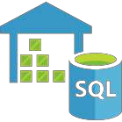












Slide 26









Slide 27









Fully featured RDBMS
RichQuery
Transactional processing
Managed as a service
Elastic scale Schema-free data model
Internet-accessible http/rest
Arbitrary data formats

Slide 28








Storage Comparison
With Azure, you have many managed data store options and you can use the right store for the job
When you need…. | Because… | But not for… | Use …
Relational store | Transactions, joins, structured data, familiar SQL query | Quickly changing data schemas | SQL Database
NoSQL key-value pair store | Low-cost, fast, massive scale | Rich query | Tables
NoSQL JSON document store | Flexible schema, familiar SQL query, low latency | Complex joins | DocumentDB
NoSQL wide- column store | Open-source, integration with Hadoop analytics | Operational simplicity | HBase on HDInsight
Cache | Increasing speed of an app | Primary data store | Redis Cache
Search service | Integrating search into an app | Primary data store | Azure Search

Slide 29







Goldilocks and the Three Bears by Jan Brett

Slide 30



















Slide 31










Slide 32
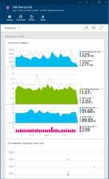
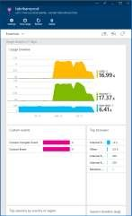
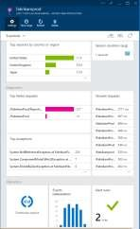



What is Application Insights?
Get a 360° view of the application including availability, performance and usage patterns
Telemetry is collected at each tier: mobile applications, server applications and browser
Telemetry arrives in the Application Insights service in the cloud where it is processed & stored

Slide 33

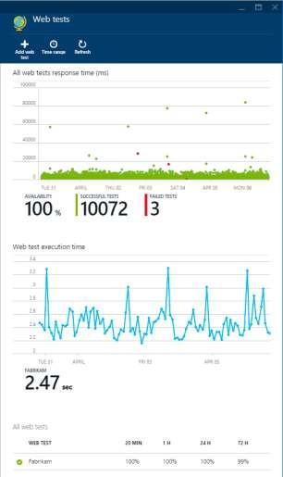
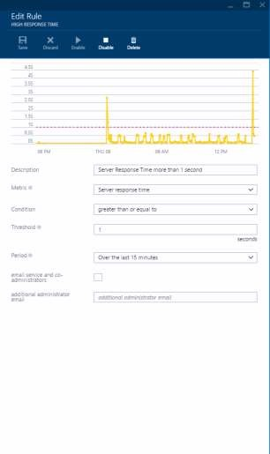






Identify & Triage issues. Availablity

Slide 34
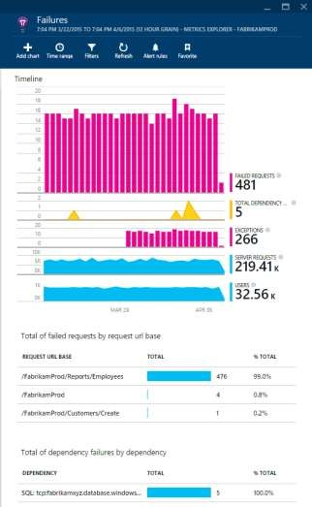
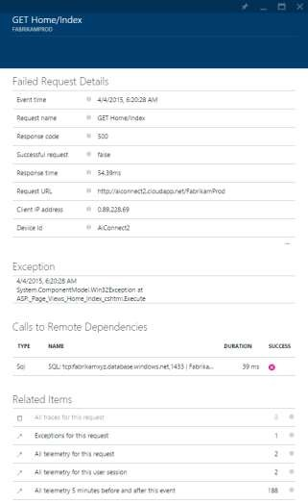







Slide 35
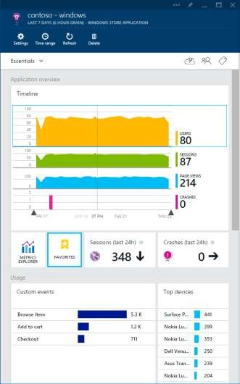
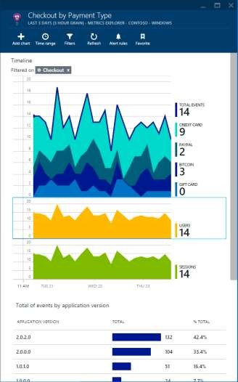




° view
o Export data to manually correlate with external data sources

